Slide 1
Dissolve and Melt
Part 1

Slide 2
Quick Write
Sometimes solids turn into liquids. How does that happen? Some people say that solids become liquids by dissolving; others say that it is because of melting.
You have 4 minutes to answer the following questions on a sheet of notebook paper.
What is dissolving and what makes it happen?
What is melting and what makes it happen?

Slide 3
Questions
How are melting and dissolving alike?
How are melting and dissolving different?
How would you melt a substance?
How would you dissolve a substance?

Slide 4
Investigation
You will be working with 2 cups of water – one hot and one cold.
You will make 2 foil cups – one foil cup will float in each cup of water.
Put one piece of candy in each foil cup and one piece of candy directly in the water.
This is a hands-off activity DO NOT DISTURB the cups.
Observe them to see if anything melts or dissolves.

Slide 5
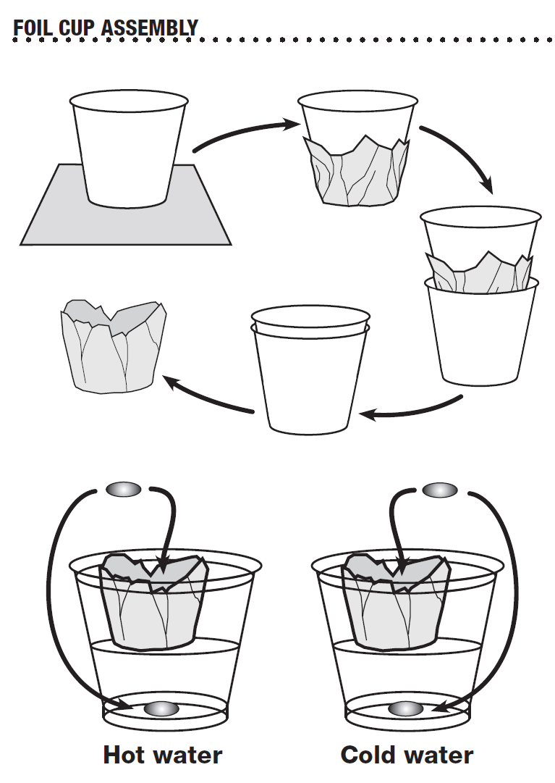
Push straight down – DO NOT twist
Caution: avoid poking holes in the foil.

Slide 6
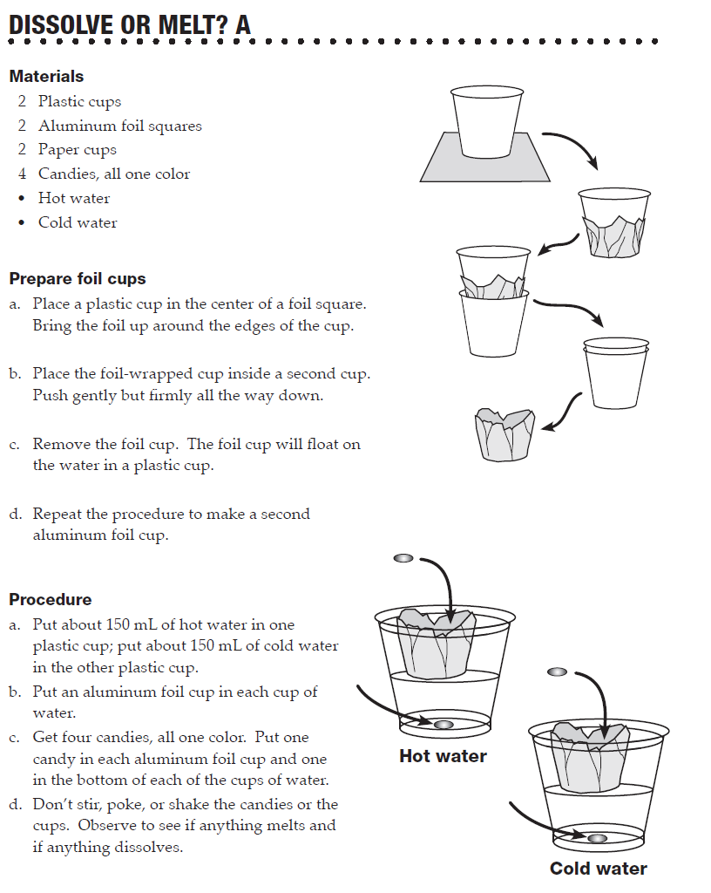
Lab book p. 60 Dissolve or Melt? A
Once the candies are put in the cups, DO NOT disturb anything!!

Slide 7
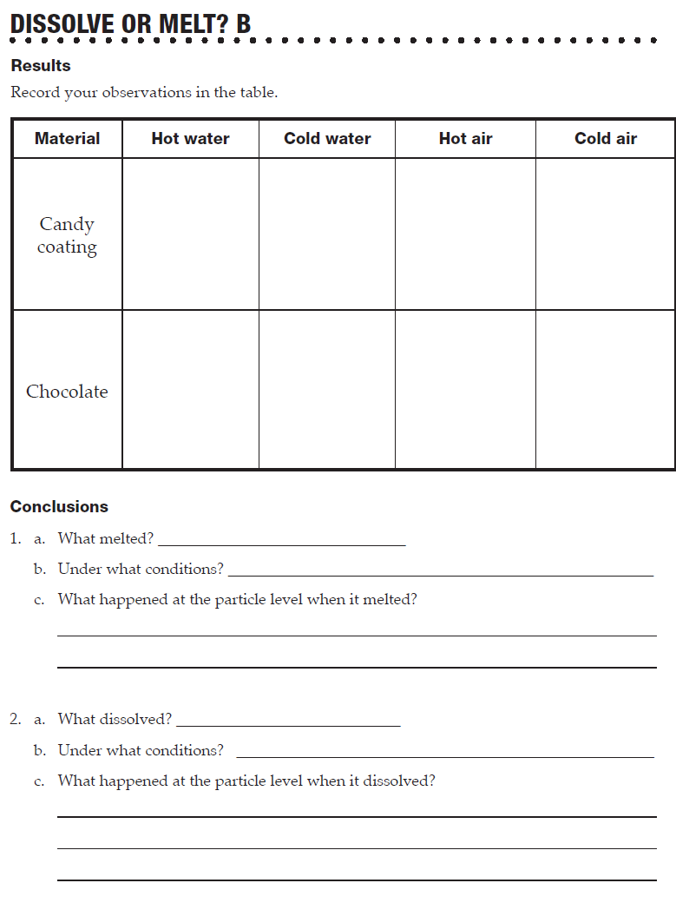
Lab book p. 60 Dissolve or Melt? B
Record your observations in the table
DO NOT complete the conclusion section at this time – wait for the discussion.
After the candies have been in the water for 5 minutes, test the hardness (remove them from the water, place on a paper towel and squash them.
You have 15 minutes to complete and clean up the investigation.

Slide 8
Dissolving
What happens to the colored coating in the water?
Where did the colored coating go?
When a solid material is placed in a liquid, and the solid disappears into the liquid, we say the solid dissolved.
Did anything else dissolve?
Did the colored coating dissolve at the same rate in both cups of water?
What was left after the color coating dissolved?
Did the chocolate dissolve?

Slide 9
Melting
What happened to the 2 candies in the foil cups?
What happened to the chocolate in the water after the colored coating dissolved?
When a material changes state from solid to liquid it is called melting.

Slide 10
Compare Melting and Dissolving
Did the candies dissolve or melt?
What was needed for the color coating to dissolve?
What was needed for the chocolate to melt?
When the color coating dissolved, where did it go?
What happened to the colored coating at the particle level when it dissolved?
What was between the particles of colored coating after it dissolved?
When the chocolate melted, where did it go?
What was between the particle of chocolate after it melted?
What happened to the chocolate at the particle level as the chocolate melted?
What caused the colored coating of the candies in the foil cup over hot water to crack?

Slide 11
Summary
When a solid substance melts, it changes state from solid to liquid. The change is caused by heat. Heat changes the kinetic energy of the particles of the substance. When the particles have a sufficient level of kinetic energy , the particles start to move past one another as a liquid. A melted substance is still made of only the particles of the substance.

Slide 12
Summary
When a solid substance is placed in water, or another liquid, particles of the solid substance break away and move into the liquid. This process is called dissolving. The liquid with the substance dissolved in it is a solution. A solution of a substance is made of particles of that substance mixed uniformly with particles of the liquid in which it is dissolved.

Slide 13
Assignment
Complete the 2 questions in the conclusion section of Dissolve or Melt ? B
Consider the theory of what is going on at the particle level.
Turn in lab book p. 61.

Slide 14
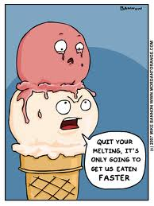
Melting Temperature
Part 2

Slide 15
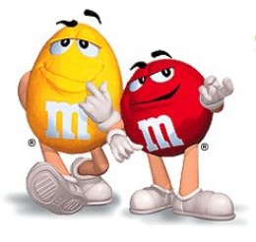
Review
What are the major distinctions in the way the 2 candies changed in the previous activity?

Slide 16
Focus on Melting
Materials can change from one state to another. We observed chocolate change from a solid to a thick liquid.
Change from a solid to a liquid is called melting.

Slide 17
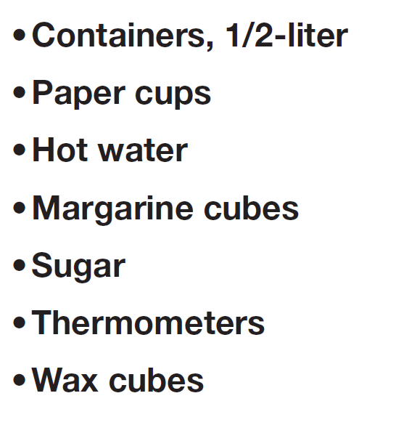
Experiment
Using these materials, design an experimental procedure to find out if the 3 materials will melt rather than dissolve in warm water.
Write your procedure (step by step) on p. 63 in your lab books.
Write your predictions on the table.
Have your procedure approved before beginning the investigation.

Slide 18
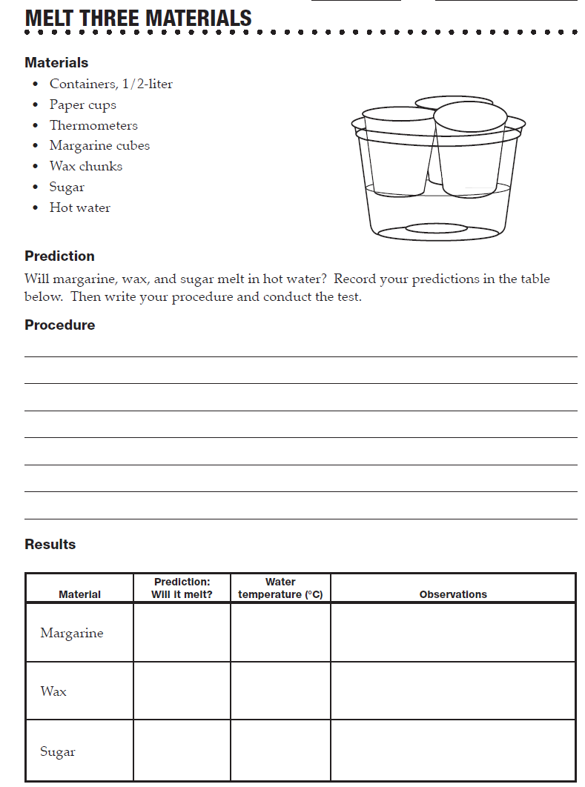
Use toothpicks to pick up margarine.
Use fingers to pick up wax cubes.
Put 2 spoons of sugar in the sugar cup.
Observe and record your predictions BEFORE getting the hot water.
After 10 minutes, record your observations.

Slide 19
Results
Which materials melted in the hot water?
What was the temperature of the water?
What was the melting temperature of the margarine?
What was the melting temperature of the wax?
What was the melting temperature of the sugar?

Slide 20
Clean up

Slide 21
Particle Model Discussion
At the start of the experiment, what state of matter was the margarine? At the end?
If you could see the particles of margarine, what would be happening to them as the margarine melts?
What would happen to the particles if melted margarine were put into cold water?
If you could see the particles of wax, what would be happening to them in the hot water?
If you could see the particles of sugar, what would be happening to them in the hot water?

Slide 22
Rewrite Quick Writes
In a different colored pen or pencil, correct and/or modify your original understanding of melting and dissolving (on your study guide).

Slide 23
More Heat
Part 3

Slide 24
Melting
Margarine melted – it turned to liquid.
Wax got soft, but didn’t really melt.
Sugar didn’t change at all.
Do you think wax and sugar can melt?
How can we find out?

Slide 25
Candles
We can use candles to heat wax and sugar. We will have to be extremely careful when working with a flame. The temperature is about 1400°C.
Any horseplay will result in immediate expulsion from the lab!

Slide 26
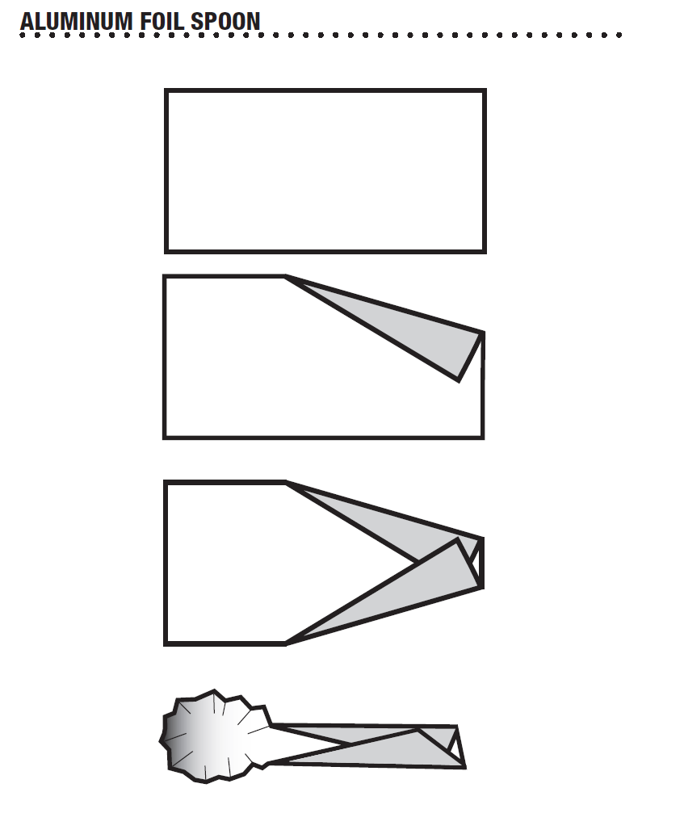
Spoon Crafting
Fold 2 corners of a foil rectangle to form a handle.
Mold the other end around your fingertip to form a pocket.
Each group will need 2 spoons.

Slide 27
Candle and Match Protocol
Each candle must be surrounded with foil.
Using a 4” x 4” piece of foil, bring the foil up around the candle and scrunch it snug.
Flare the top of the foil away from the candle. The foil should catch any melted wax that runs down the side.
Matches will be distributed one at a time with a piece of striking surface. If your match does not light, you can exchange it for a new one.

Slide 28
Safety
Keep paper, hair and sleeves away from the candle.
Avoid touching hot spoons or melted material, particularly the wax.
Protective eyewear must be on BEFORE the candle is lit and remain on until the lab is completed.

Slide 29
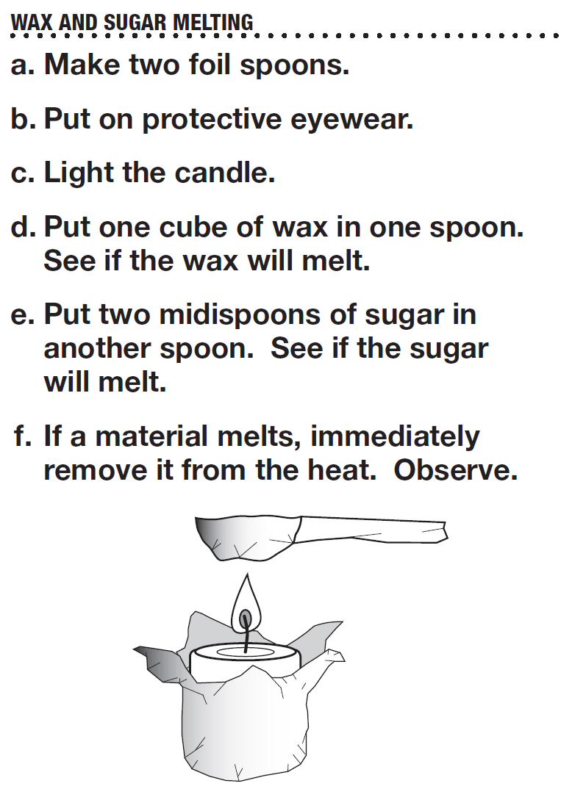
Melting
Heat the materials cautiously.
Place the spoon over the flame for a few seconds.
Remove and observe.
Continue, heating only a few seconds at a time.
If you have success in melting, remove it from the flame – DO NOT continue to heat.
Observe the melted material after it has been removed from the flame.

Slide 30
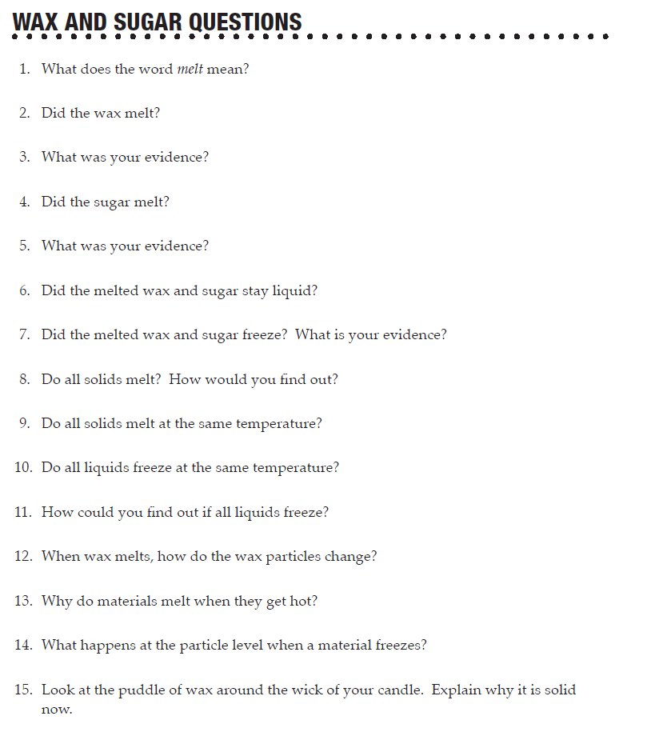
Lab book p. 64 – discuss in your groups for 5 minutes.

Slide 31
Summary
Melting is a change of state from solid to liquid. Freezing is a change of state from liquid to solid. Change of state is the result of a change in kinetic energy of the particles of a material. Nothing changes during a change of state except the motion of the particles. The particles do not
MELT OR FREEZE
CONTRACT OR EXPAND
OR CHANGE INTO ANY OTHER KIND OF PARTICLE

Slide 32
Summary
A change of state is not a chemical reaction, so no new products are formed.
Substance freeze at their own temperature.
Water 0°C
Iron 1538°C
Alcohol -98°C

Slide 33
Lab book - p. 67 - Quiz
Response Sheet – Phase Change

Slide 34
Assignment
Read Rock Solid in your resource books.
Answer the questions in your lab book p. 65

Slide 35
Freeze Water
Part 4

Slide 36
Melting Review
What did you observe about the 4 substances we melted?
Melting requires ____________.
When enough heat energy transfers to the particles of a substance, the particles start to move over and around one another.
Ice is a solid. Ice melts when it is heated to its ______________ which is 0°C.

Slide 37
What are some ways we could freeze a small volume of water?

Slide 38
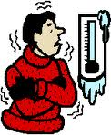
Water in Ice
What is the temperature of the water in the vial?
Water freezes at 0°C. Is the water frozen?
Will it freeze in a while?
What do we need to do to get the water to freeze?

Slide 39
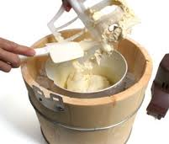
Homemade Ice Cream
What do you add to the ice when you make ice cream?
Why do you think you added salt to the ice?
Do you think salt will help us freeze water?

Slide 40
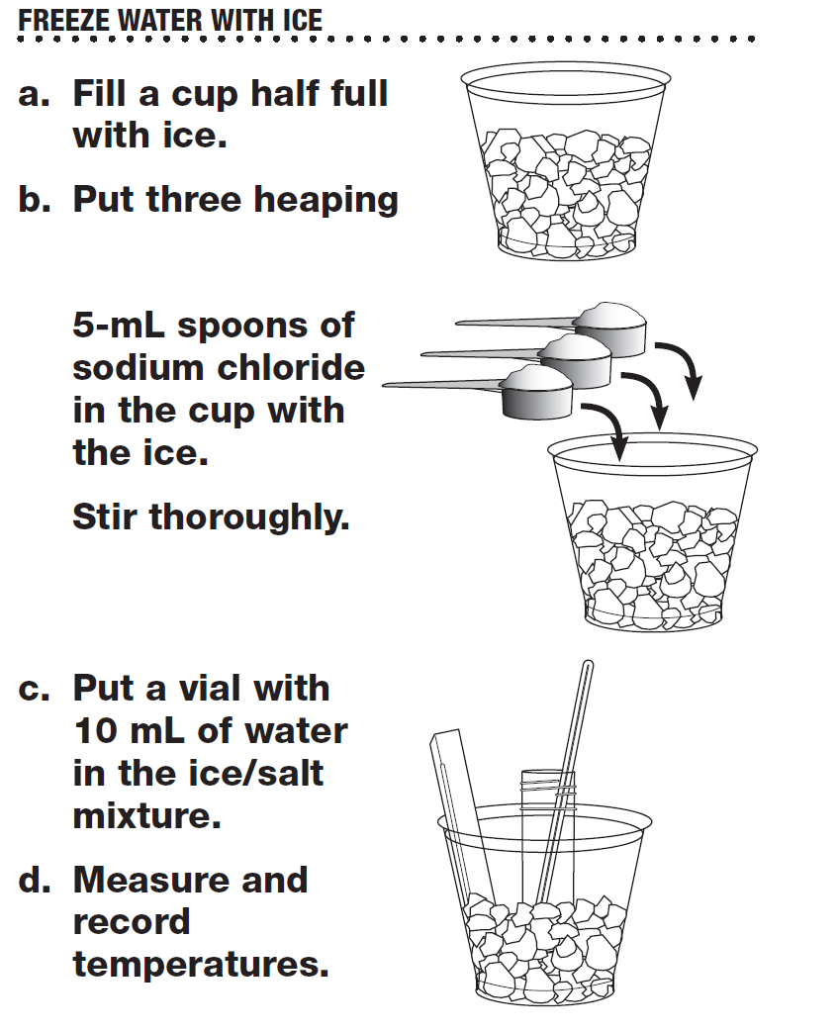
Lab book p. 69 – Freeze Water

Slide 41
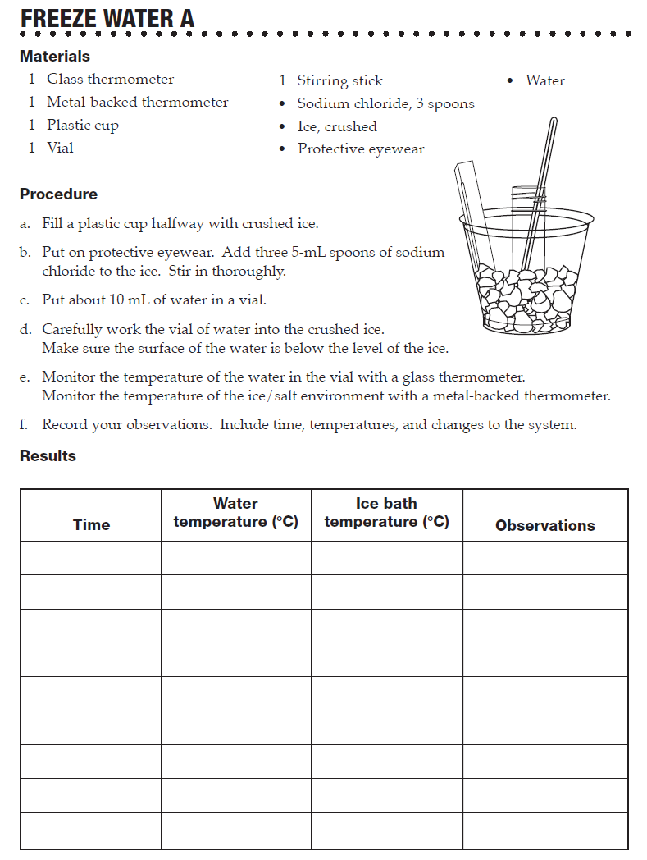
Recording
Make your first time and temperature recordings as soon as you place the vial in the ice.
Make subsequent recordings every 3 minutes.
Be sure to use metal backed thermometer in the ice, and glass thermometer in the vial.
Be sure the water level in the vial is BELOW the ice.
Be sure to make observations.

Slide 42
Clean up
Rinse and dry all materials and return to the material table.

Slide 43
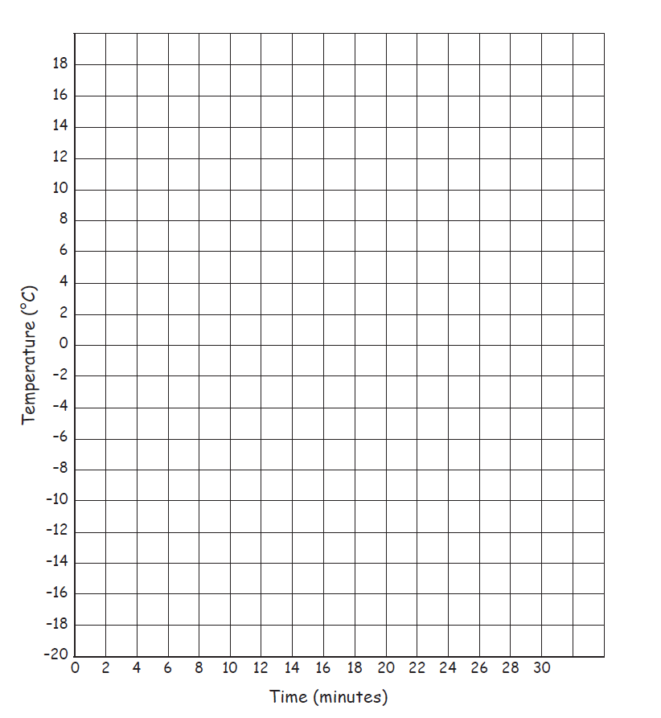
Lab book p. 70 – Freeze Water B
Graph your data.
Draw 2 lines on the graph.
One that connects the data points.
One that is a best fit line.

Slide 44
Discussion
Describe what happened to the Ice/Salt mixture as the investigation progressed.
The temperature plunged at first to about -10°C than slowly began to rise.
Describe what happened to the vial of water as the investigation progressed.
Water was liquid until a few minutes after the temp. dropped to 0°C
What happened to the temperature of the water in the vial as it was freezing?
The temperature was 0°C the whole time the water was freezing
Why do you think the water surrounded by ice didn’t freeze, but the water surrounded by the salted ice did freeze?
Plain ice wasn’t cold enough. The salt dropped the temperature low enough so that the water in the vial froze. It reached the heat of fusion.
People put salt on ice when they make ice cream. Why do they do that?
IT makes the environment around the ice cream cold enough to freeze. Energy is transferred from the ice cream to the salt/ice environment. Once energy transfer exceed the heat of fusion, the ice cream freezes.

Slide 45
In the last investigation, we discovered that a lot of heat had to be transferred TO ice at 0°C to change it to water at 0°C. The energy need to melt a substance is called ___________________________.
Heat of fusion works the other way too. A lot of heat must be transferred FROM water at 0°C to change it to ice at 0°C. This energy is also called the heat of fusion.
In the case of water, you must transfer ____ calories AWAY FROM a gram of water at 0°C to change it into a gram of ice at 0°C.
Therefore, Heat of Fusion is the amount of heat needed to change the state of a substance from solid to liquid OR liquid to solid.

Slide 46
Assignment
Using your graph, answer the questions on p.71
Turn in p. 70 and 71
Complete Study Guide for Phase Change – Freeze Water.

Slide 47
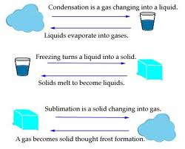
Gas to Solid
Part 5

Slide 48
Review
What phase changes did you observe in the activity with sugar and wax?
What can you do to get a solid material to melt?
What happens to the solid material AT THE PARTICLE LEVEL when it melts?

Slide 49
Hot Water
This substance has been heated so that the particles have so much kinetic energy that the substance is a LIQUID.
What would happen if I continued to transfer heat to it?
What would happen to the particles if the kinetic energy continued to increase?

Slide 50
Gas
The particles in gas travel in straight lines through space as individuals.
The average distance between them is relatively large.
When the particles in a substance have enough kinetic energy to break away and fly into space, the material substance changes to the gas phase.

Slide 51
If water boils and turns into gas, where does it go?
Into the air
What is water gas called?
Water vapor
What does water vapor look like?
Nothing – it is invisible
When water turns into water vapor, a gas, is it still water, or is it something else?
Still water

Slide 52
Getters get a 500 ml cup 1/3 full of hot water.
Observe your cup of hot water (2 minutes)
What do you see?
If water in its gas state is invisible, what can we do to find out if water vapor is present?
Cool it down to change its state back to a liquid so that is can be seen.

Slide 53
Lab book. p.73
Getters get 2 cups half filled with ice per table.
Set up your ice-water system.
Observe.
Share observations.

Slide 54
Observations
You can see steam, fog, or dew on the cup. What are they made of?
Liquid water
Where did the liquid water come from?
From the water vapor in the air
What happened AT THE PARTICLE LEVEL to cause the change from gas to liquid?

Slide 55
Condensation
When energy transfers from the water vapor particles, their kinetic energy decreases. The particles stop flying around as gas and bunch together as liquid.
The process of changing state from gas to liquid is
CONDENSATION

Slide 56
Evaporation
When energy transfers to the particles in liquid water, their kinetic energy increases. When a particle gains enough energy to escape the other particles, it flies off as a water vapor particle.
Changing state from a liquid to a gas is called
EVAPORATION

Slide 57
Break

Slide 58
Another Phase Change
Water condenses on the ice cup. Where did it come from?
Why did liquid water condense on the bottom of the ice cup?
We observed a phase change from gas to liquid in the hot-water-and-ice-system. How could we create another phase change in the system from liquid to solid?

Slide 59
Getters pick up stirring sticks and 10 ml of salt.
Carefully stir the salt into the ice.
Let the system rest for 3 minutes. DO NOT MOVE IT!
CAREFULLY Lift the ice cup an observe the bottom.
What do you see?
Return the cup for another 7 minutes.

Slide 60
Lab book p. 73
Work alone to complete.
Describe in detail what happens at the PARTICLE LEVEL. As the water changed phase.
Start with the particles in the hot liquid water, and end up with the particles in the solid ice on the cup.
Wait quietly until all have finished.

Slide 61
Summary – lab book p. 73
Heat in the warm water increased the kinetic energy of some of the water particles.
The particles with sufficient kinetic energy fly free from the bunched particles in the liquid. This is called EVAPORATION.
Water vapor particles strike the cold ice cup. Energy is transferred from the particles to the cold cup.
Energy transfer from water vapor particles reduces the kinetic energy of the particles. They stop flying around and bunch up with other water particles to form liquid water. This is called CONDENSATION.
Salt added to ice makes it colder. Energy transfers from liquid water particles. The kinetic energy of particles is reduced.
Reduced kinetic energy prevents particles from moving over and around the other particles, so they are locked in place. Liquid water changes to solid ice. This is called FREEZING.

Slide 62
What will happen when all of the ice inside the cup melts?
Water inside the cup will receive energy from the warm air. Energy will transfer from the cup to the iced on the outside of the cup. The kinetic energy in the particles of frost will gain kinetic energy
When the particles have enough kinetic energy to move over and around one another, water will change to a liquid state . This is called ____________________.

Slide 63
Clean up
Clean and return all material to the materials station.

Slide 64
Mid Summative Exam 7

